Slide 1
Digital Dive Log Signature System (DDLS)
By: Aaron Suchovsky and Vince Augustine

Slide 2
Goals
Our goal is to create a well working automated version of the outdated dive log system
It will allow dive masters and divers to collaborate on dive logs and signatures.
Divers and Dive Masters can send logs via the app to get their logs signed digitally.
This process will allow divers to not have to physically hand their logs to the master.
Background of the app
AJ is a ROTC student here at UC and he is a certified diver.
One of his dive masters made a comment about an app that will automate the outdated “pen and paper” method of signing off on dive logs.

Slide 3
Intellectual Merits
This app is the process of taking an outdated system and making it automated and modern.
An example of how software engineering can make the world a more automated and easy place to live.
The proposed app demonstrates how the idea of a easier process of making a dive log can be executed through the development of an app.
THis new method of dive log creation will allow divers and dive master have the power to create and share logs through the internet. This is a new process for divers and will be cutting edge based on the previous system of physical logs.

Slide 4
Broader Impacts
This app will impact the diving world in the most positive way.
It will make the lives of divers and dive masters much easier through the creation of the app.
Divers will no longer have to travel and hand logs in physically, which create more of an automated and easy system.
With this app, many more people will want to start diving because of the ease of an automated system.

Slide 5
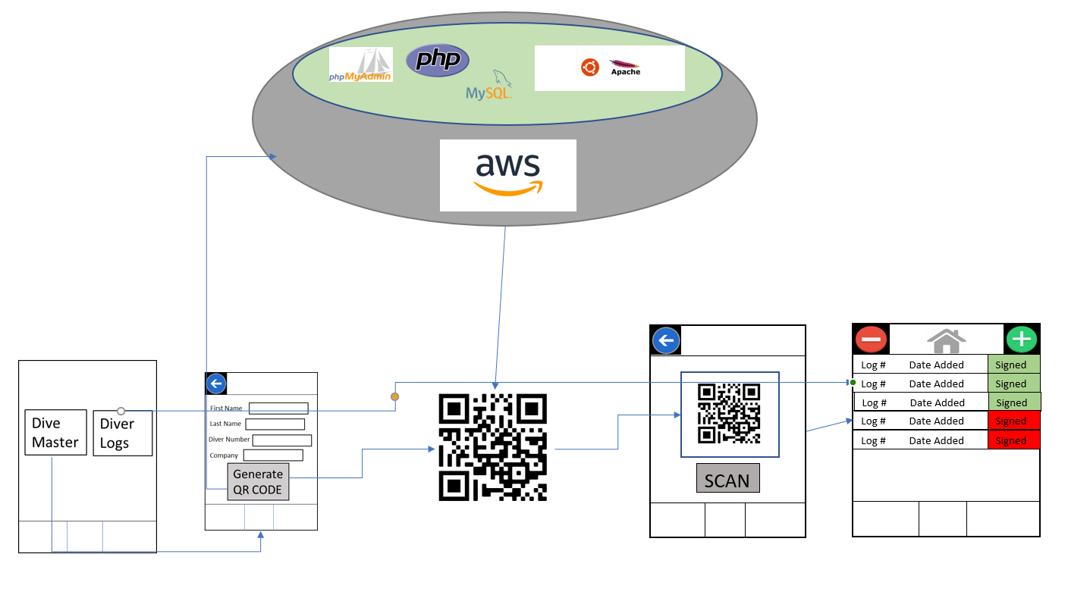
High Level Design Diagram

Slide 6
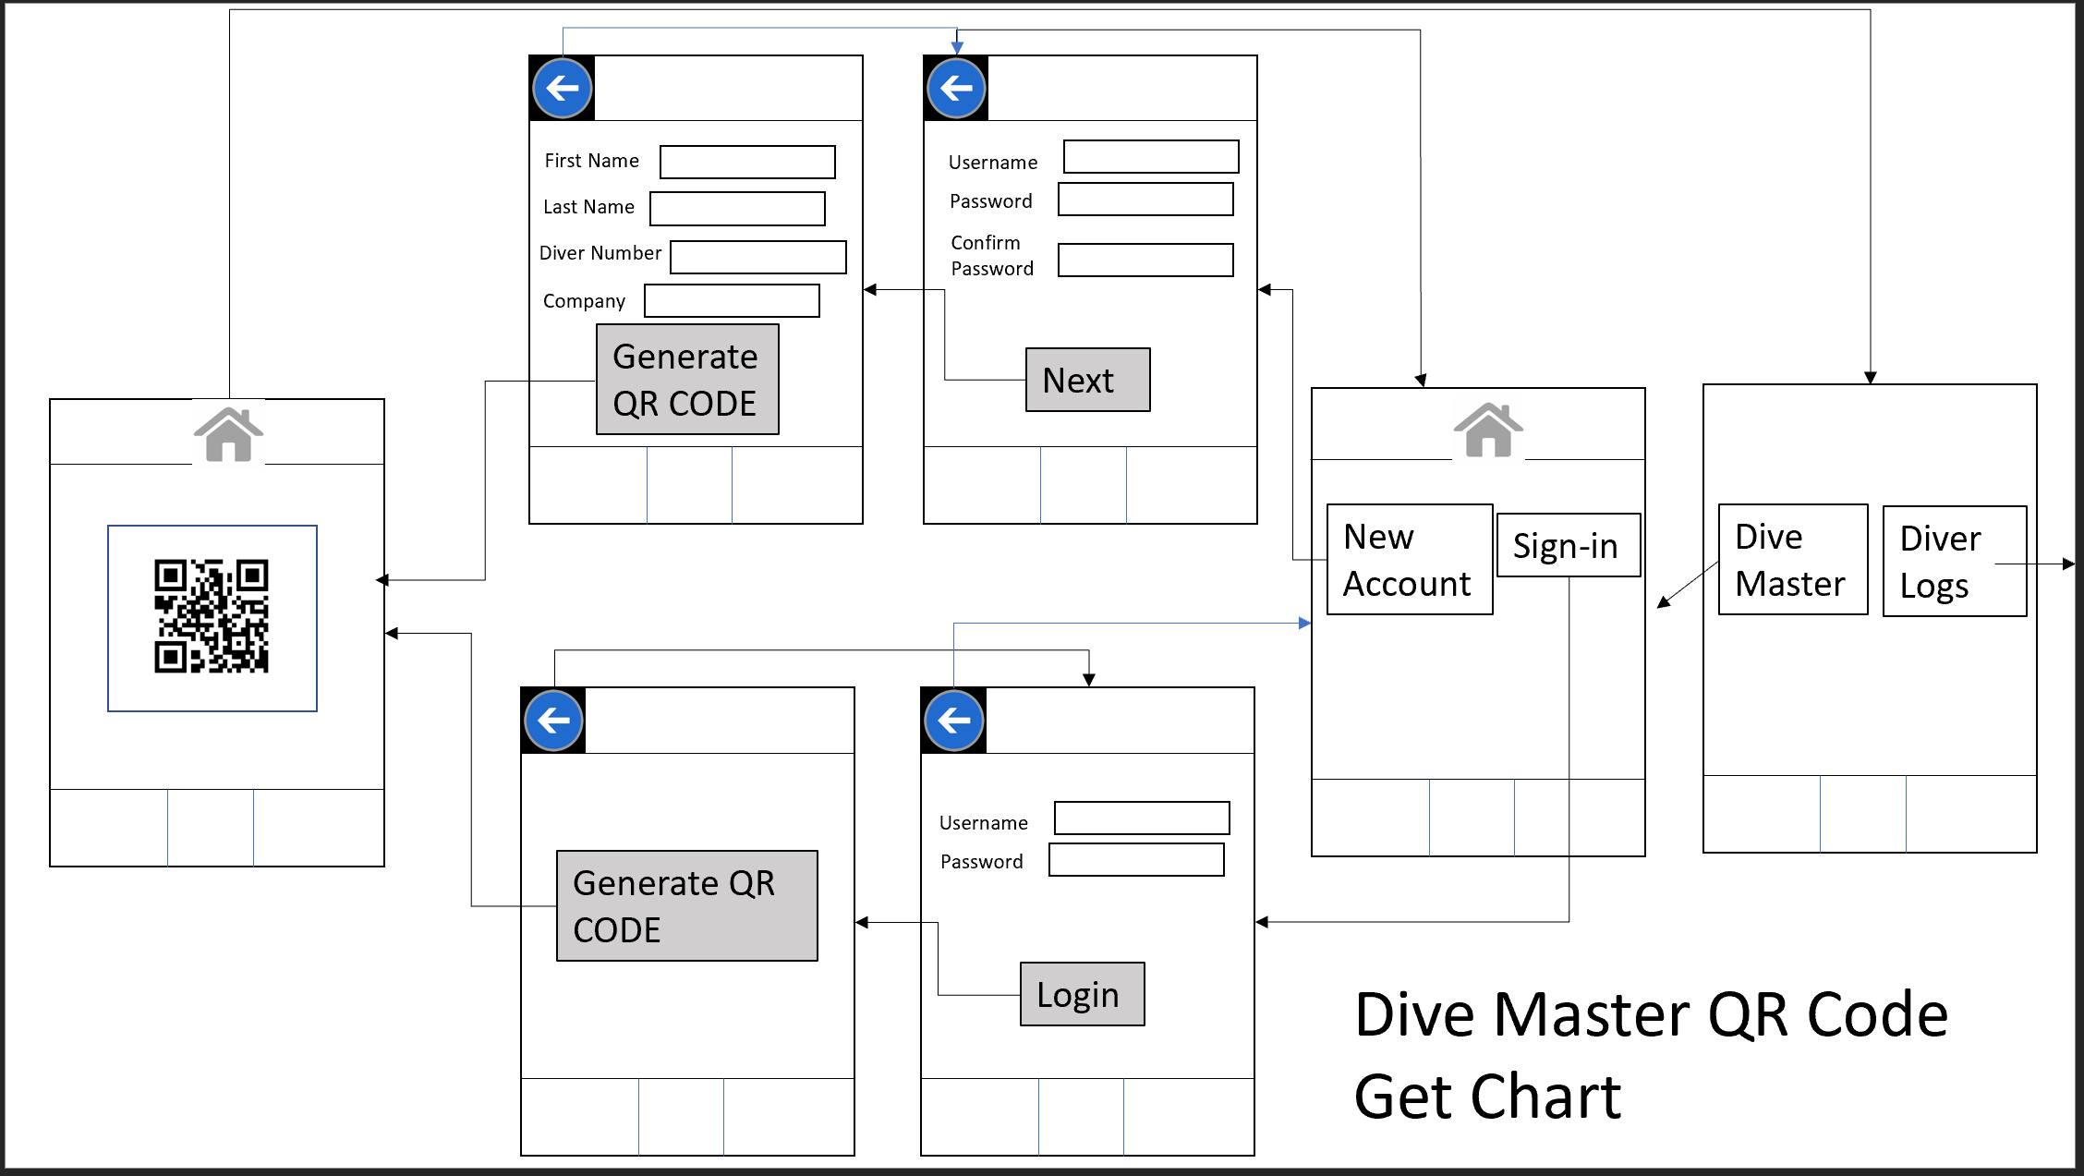
Design Specifications

Slide 7
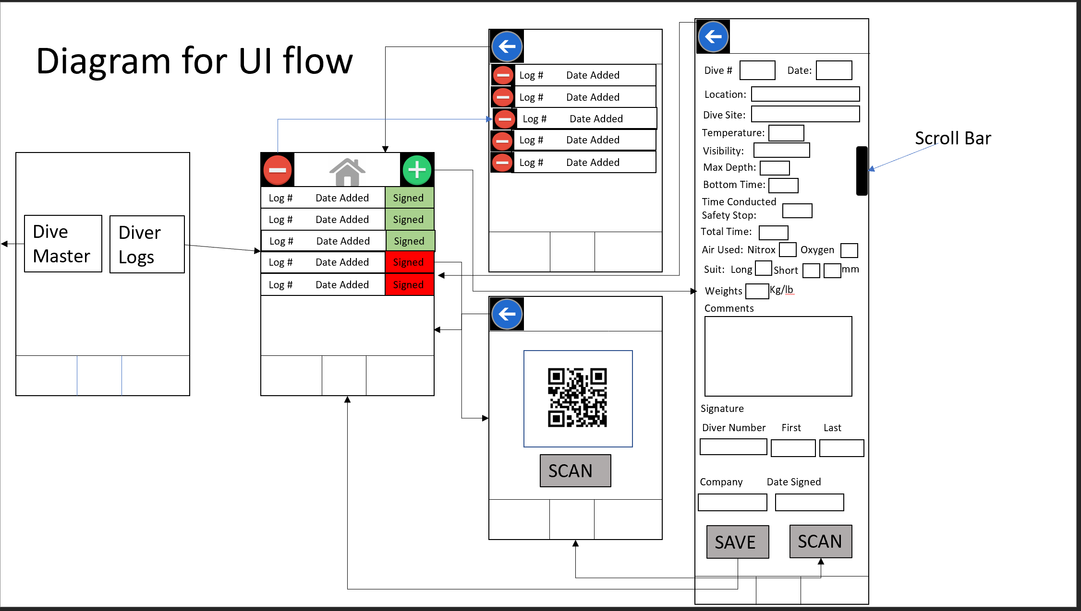
Design Specifications (Cont.)

Slide 8
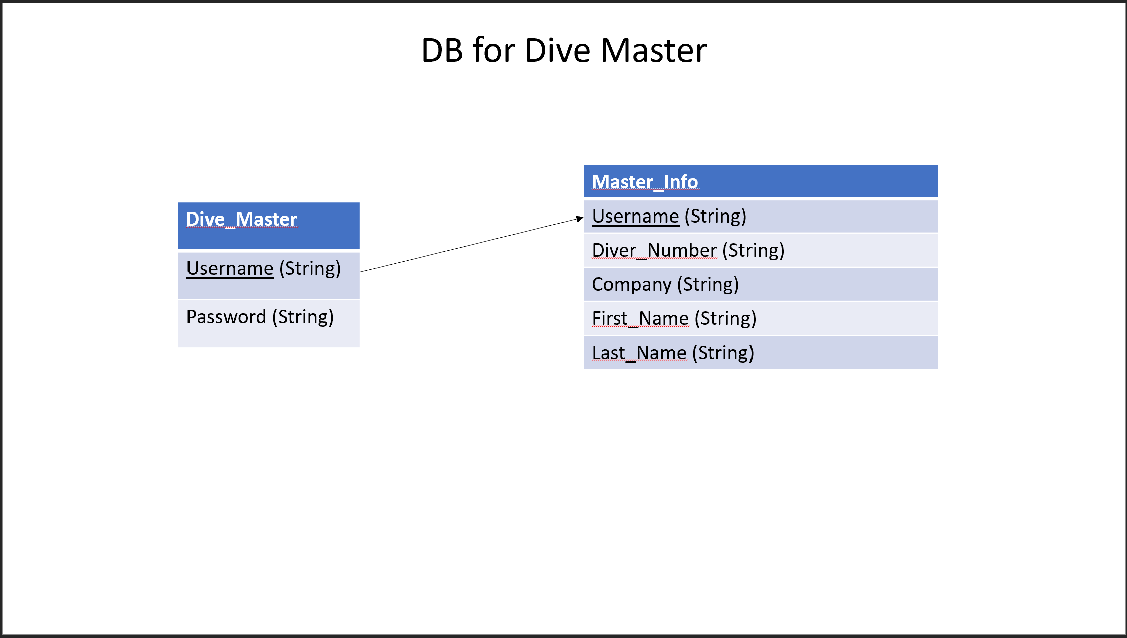
Design Specifications (Cont.)

Slide 9
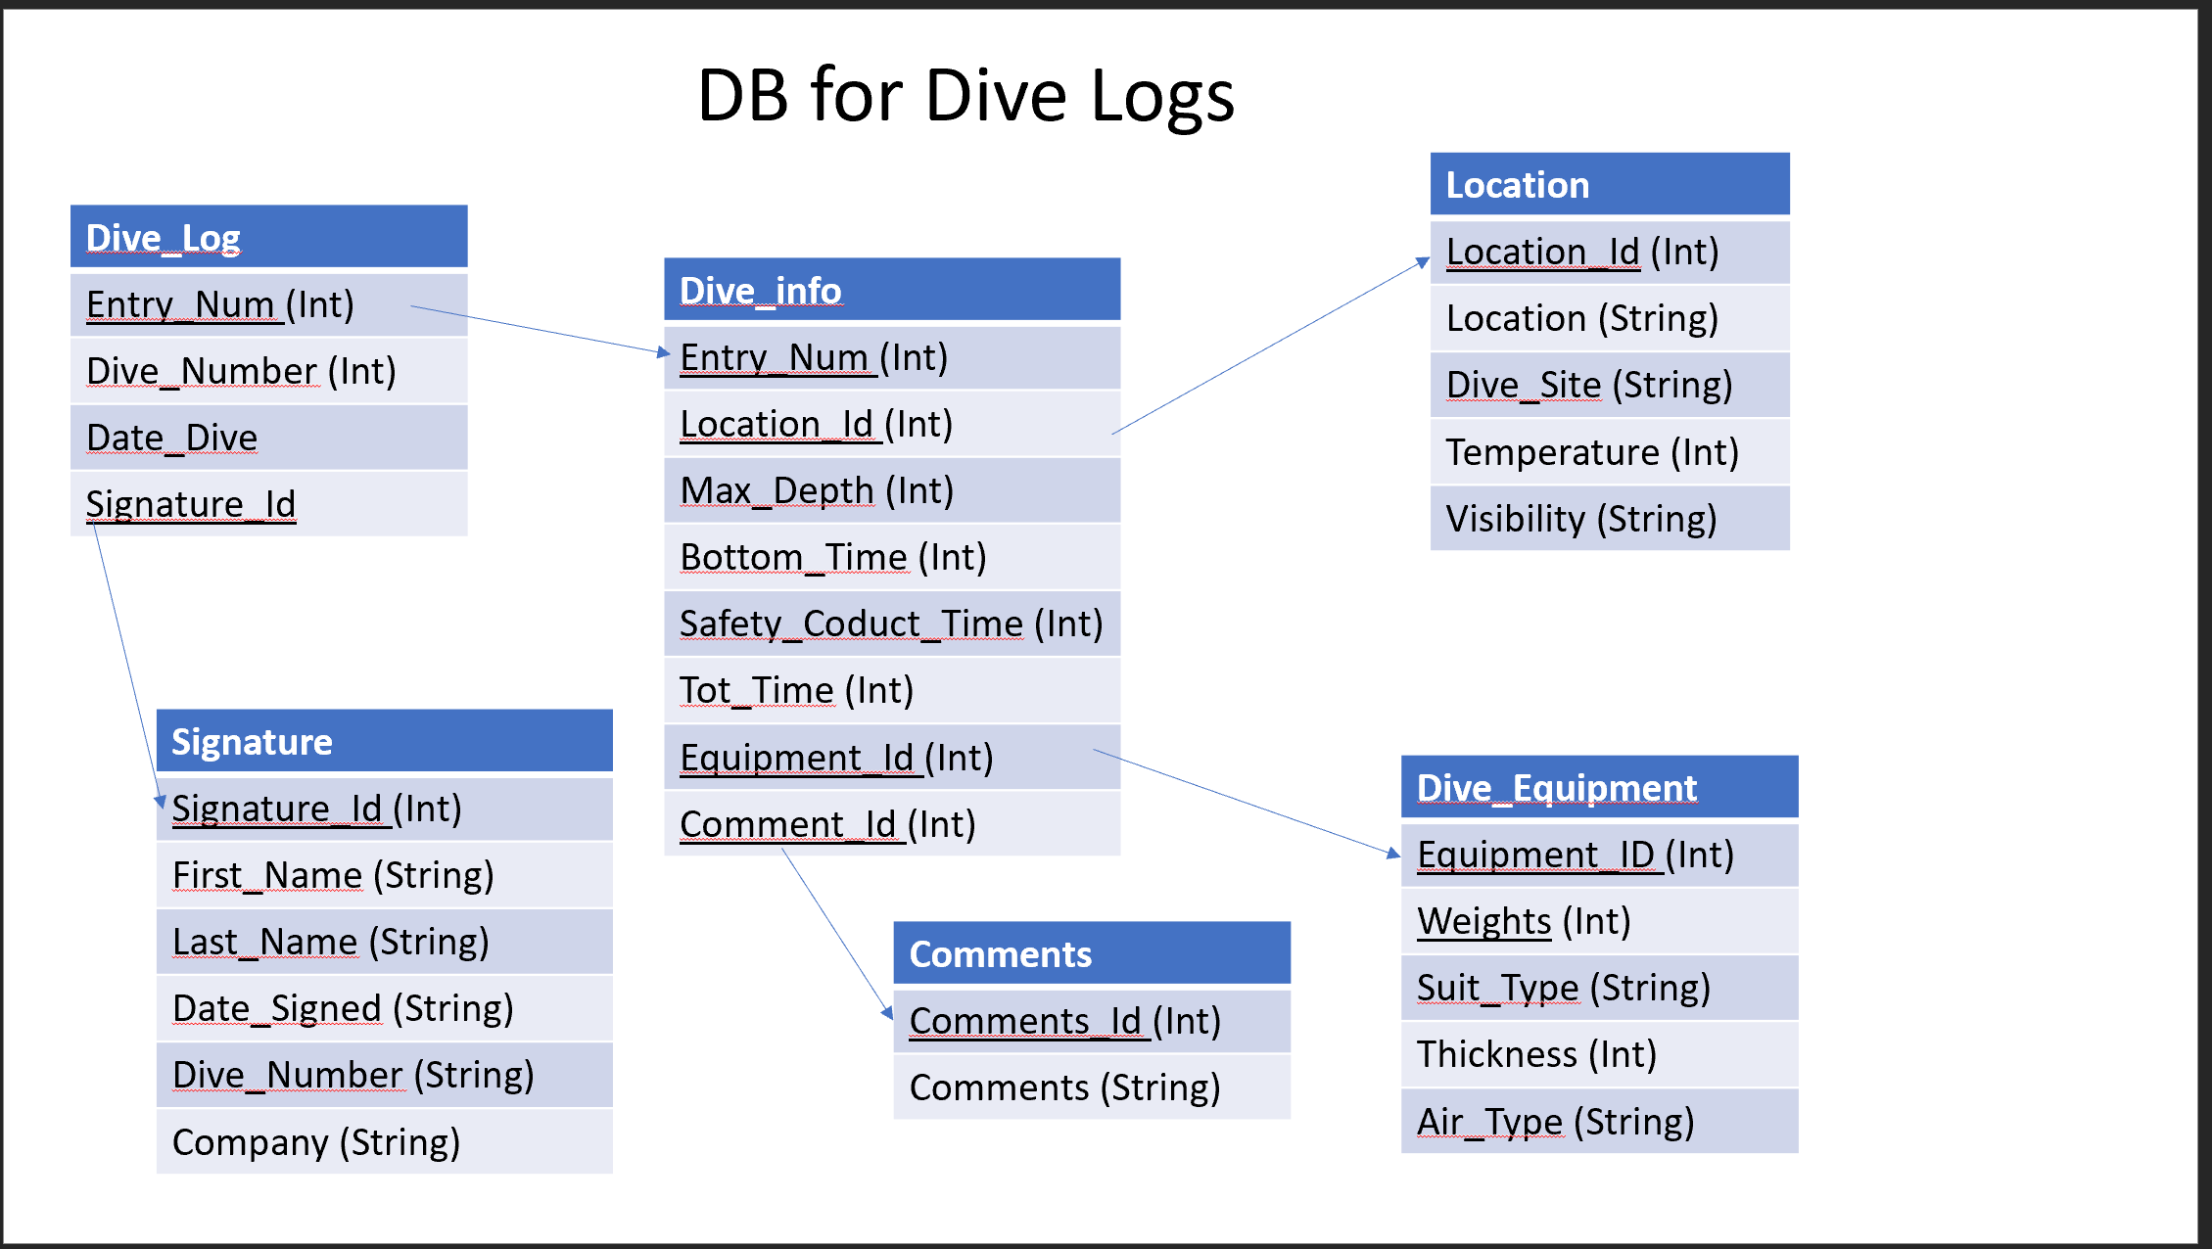
Design Specifications (Cont.)

Slide 10
Technologies
Android Studio - the main application used to create the DDLS App
Amazon Web Service - this is the main service in which the MySQL server is stored on as well as PHP scripts, phpmyadmin, and Apache2 web services.
MySQL - the database host that is used to store the Dive Master information and that can be
PHP - used to transfer information sent from DDLS to the the MySQL DB and back. These scripts are located on the AWS server.
Phpmyadmin - interface that makes monitoring MySQL databases more efficient
Ubuntu 18.04 LTS - The operating system that the AWS server is running

Slide 11
Milestones
1. All research gathered. This includes how and what to use for the database, refresh on how to use Android Studio, and how QR codes work. The deliverable for this is either in the form of notes or explanation of items that we used in our documents. This is a list of specific things either researched or decided on.
2. Start designing user interfaces and the SQL database. This will be in the form of how tables will interact with each other before coding the table so that we can link tables and have a visual representation of how this will look. Going in and making the SQL table without this could result in a lot of wasted time trying to fix issues. This goes with the interfaces as they will need to be designed before coded in order to reduce unforeseen issues that may arise in the design and transition from pages of the App.
3. Start coding the Database. The deliverable for this will be a fully functioning SQL database that can both send and receive information. This will be made with SQL and will have all parts from the design implemented.
4. Start coding Interface. This will take the longest and will need to be broken up further which is in the task list and Timeline. The deliverable for this will be actual code documents made and progression towards an actual App.

Slide 12
Milestones (cont.)
5. First prototype test. The deliverable for this will be the whole app and database doing the function of scanning a QR code and getting a response on the dive log. This will be the most basic form and will not have bells or whistles attached to it.
6. Second prototype test. This will be after all the bugs from the first prototype are taken care of as well as any bells and whistles that have been decided to add on. The main deliverable here is the App without the bugs from the first prototype test. Any additions are more icing on the cake.
7. Final Product with deliverable for senior design. The deliverable here will be everything we have previously done as well as a board to present in the Senior Design Fair. This will consist of the board and the third prototype or the second in a successful state.

Slide 13
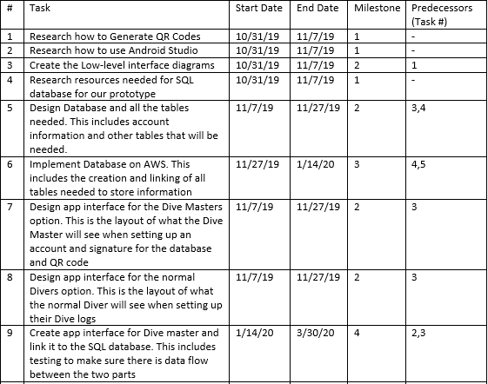
Timeline

Slide 14
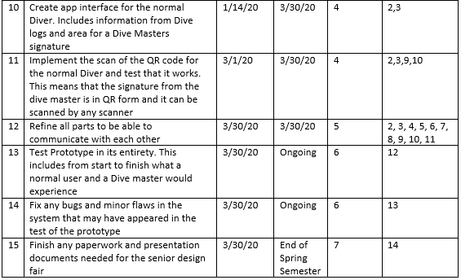
Timeline (cont.)

Slide 15
Results
Achieved the UI creation of the App
Creation of an online database
A way to connect to database and retrieve data
Creation of mysql database for user dive logs on local phone
Need to still accomplish:
Merging connection to online database into UI
Merging creation of local dive log database into the UI
Creation of QR code from retrieved data from online database when Dive Master logs in as well as merge it into the UI
Ability to scan QR codes and fill in for the Dive Logs.

Slide 16
Challenges
Creating the Database to store Dive Master information - This was originally on a Raspberry Pi 4 but due to some issues with connecting to it, an AWS server was created in its place making connecting to it easier and easier to manage.

